Slide 1
Creating Custom Players with BEML
Brightcove Video cloud training
Notes:
1

Slide 2
Introduction

Slide 3
Player Customization with BEML
Designed to meet the needs of those responsible:
Web developers and designers responsible
Designing
Styling
Publishing
Distributing video players
A basic understanding of html and/or xml is required.
Notes:
3

Slide 4
Agenda
Introduction
Introduction to BEML
Using BEML Components
Using Layout Containers
Data-Binding
Styling

Slide 5
Spectrum of Visual Customization
Methods
Publishing Module
Design Capabilities
Out-of-the-Box Templates
Styling
Basic Design
Skills
Notes:
5

Slide 6
Player Creation Process
Choose a Template
Create a Player
Configure Settings
Customize Style
Preview Player
Add Playlist(s)
*
*Only if using a multiple video player
Notes:
6
6
How abut we have a box that shows where BEML gets added in this…

Slide 7
Customizing Out of the Box Templates
Out of the box templates can’t be modified beyond styling and (in some cases) resizing
They can be duplicated, and the copies can be modified using BEML – good way to get started with BEML
Notes:
7
7

Slide 8
Spectrum of Visual Customization
Methods
Publishing Module
BEML
Design Capabilities
Out-of-the-Box Templates
Styling
Layout
Size
CSS
Basic Design
HTML / XML
Skills
Notes:
8

Slide 9
Player Creation Process
Create a BEML Template
Create a Player
Configure Settings
Customize Style
Preview Player
Add Playlist(s)
*
*Only if using a multiple video player
Notes:
9
9
How abut we have a box that shows where BEML gets added in this…

Slide 10
BEML = XML!
The basics of XML
At W3C http://www.w3.org/XML/)
The XML FAQ (http://xml.silmaril.ie/)
At Wikipedia (http://en.wikipedia.org/wiki/XML)
Names are case-sensitive!
Element
Attribute
Attribute Value
<Runtime>
<Theme name="Deluxe" style="Light" />
<!-- This is an XML comment -->
<Style id='default'>
<![CDATA[.titleText {size: 12;}.}]]>
</Style>
<Layout width="486" height="416">
<VBox padding="3">
<VideoPlayer id="videoPlayer" />
</VBox>
</Layout>
</Runtime>
Quotation marks required!
Include data
Required
Root
Element
Nesting
All tags must be closed!

Slide 11
Basic Structure of BEML Code
Components
Layout
Styling
<Runtime>
<Theme name="Deluxe" style="Light" />
<Layout width="486" height="416">
<VBox padding="3">
<VideoPlayer id="videoPlayer" />
</VBox>
</Layout>
</Runtime>
Theme and Style
Required
Root
Tag
Components
Layout Wrapper
And Elements

Slide 12
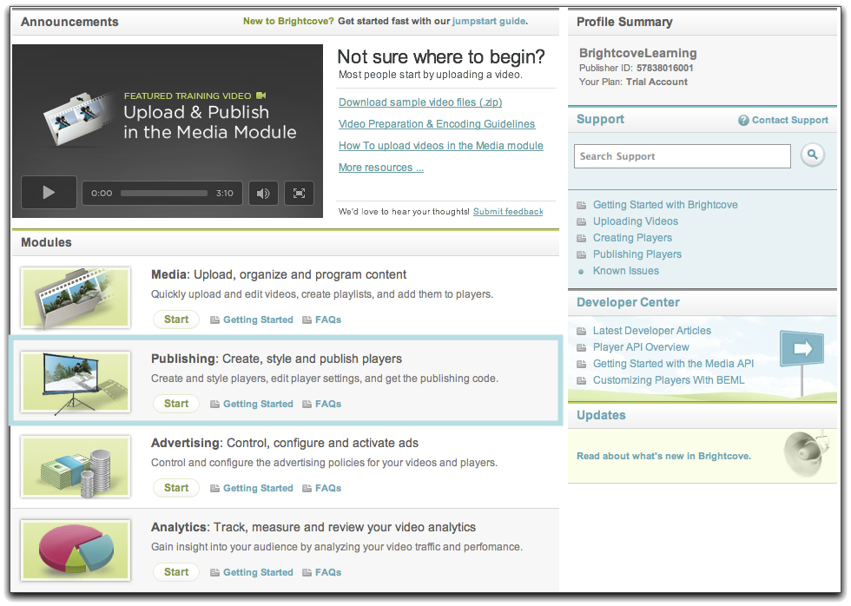
Creating a template – demonstration
Creating a Template -- Demo

Slide 13
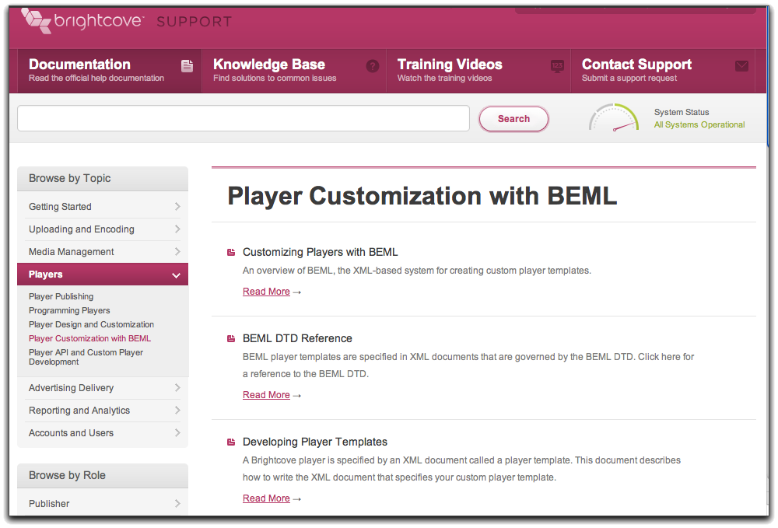
HELP

Slide 14
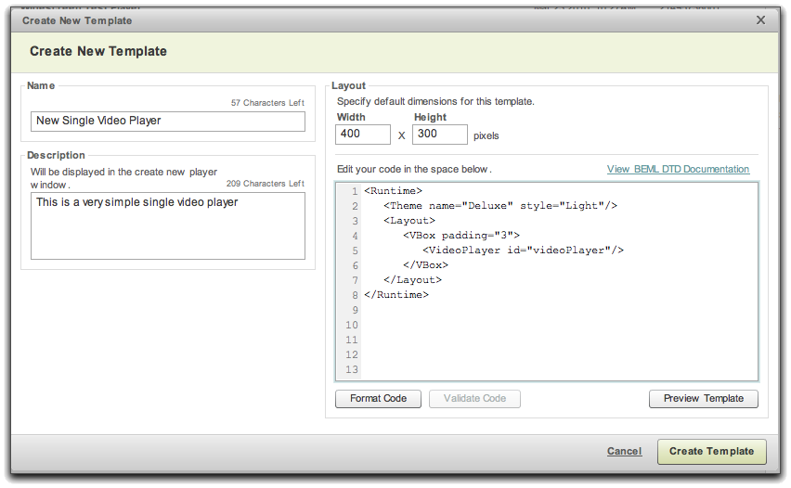
The DTD - Document Type Definition
You can also reference the DTD itself if you have an XML editor that is capable of using it for validation, code-completion, etc..
<!DOCTYPE Runtime SYSTEM http://admin.brightcove.com/dtds/beml_rt.dtd>

Slide 15
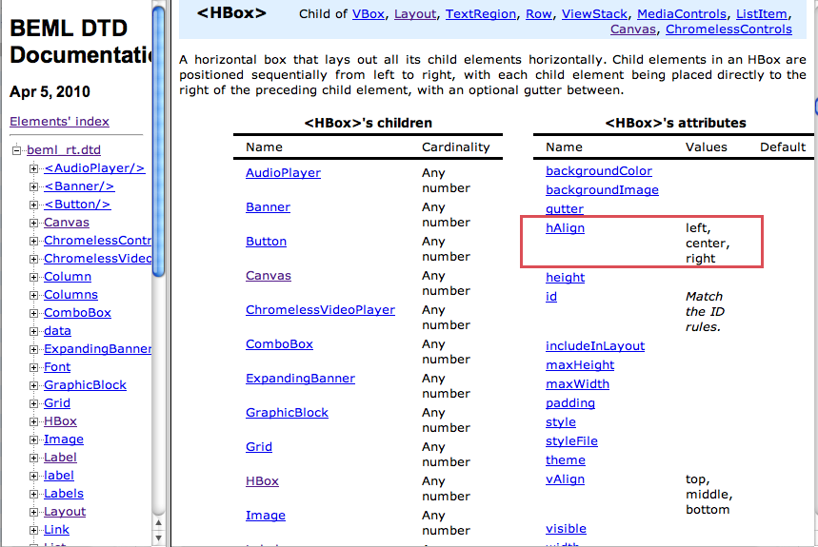
BEML DTD Reference
Note: in some cases attribute values are restricted and case-sensitive
http://docs.brightcove.com/en/beml/
Notes:
In case you get stuck…here are your help resources….
If you use any type of XML editor I highly recommend downloading the DTD to do validation.
The XML used in a player template is defined by the Document Type Definition (DTD)

Slide 16
Exercise 1: Creating a Simple BEML Template

Slide 17
Components
Notes:
17
Break before this.

Slide 18
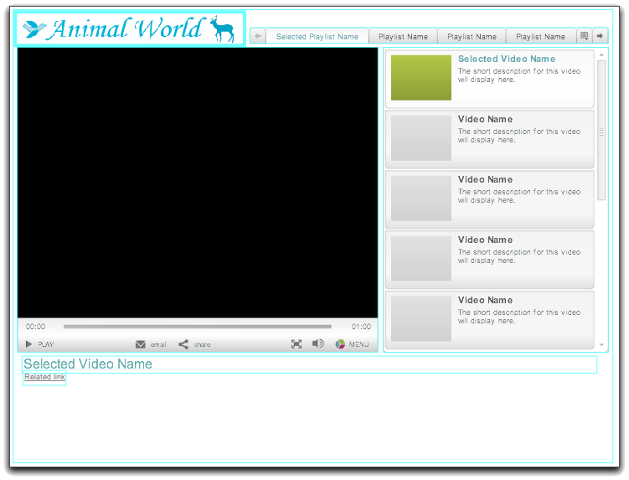
BEML Visual Components in a Player
Image
TabBar
Note: this could be a VideoDisplay with a separate MediaControls component, or a VideoPlayer
List with ListItems
TitleLabel
Link
Banner
Notes:
18

Slide 19
Video Player Component
VideoPlayer: A video window and a set of media controls
A play/pause toggle
A timeline scrubber
Volume controls
Maximize controls
A menu access button
<VideoPlayer id='videoPlayer' width='480' />
ChromelessVideoPlayer
Like the VideoPlayer, but with chromeless controls
VideoDisplay: video window without the standard media control bar
<VideoDisplay id="videoPlayer"/>
Use with the media control components:
MediaControls (wrapper for the individual controls)
Playhead
VolumeControl
ToggleButton
ComboBox
Notes:
19

Slide 20
The Image Component
Loads a scalable visual element into a player: JPEG, GIF, SWF
<Image id="logo" height="56" width="404" source=""/>
Note: you could set the source URL here, or leave it blank to set the image in player styling in the Publishing Module
Notes:
20

Slide 21
Link Component
Provides a means to display clickable text within a player
used to navigate to another URL
or to call JavaScript
<Link width="397" height="20" text="Go to wired.com to see more videos" url="http://www.wired.com/video"/>
Notes:
21

Slide 22
Label Component
A simple text component that allows for any text to be added to a player
Can be bound dynamically to any other component's property
<Label width="160" height="40" text=“You are Watching" />
Notes:
22
Clean up this slide…..

Slide 23
Spacer Component
A formatting component that creates space between other elements
Invisible element to assist in layout positioning
<Spacer height="10" />
Notes:
23

Slide 24
Component Attributes
Common Attributes
Id
Width
Height
X, Y (if using Canvas)
Source (for data binding)
Component Specific
Example: VideoPlayer
autoStart
preventFullScreen
video
Note:
an id in XML must be unique within the document
ids must have specific values for some elements for data binding

Slide 25
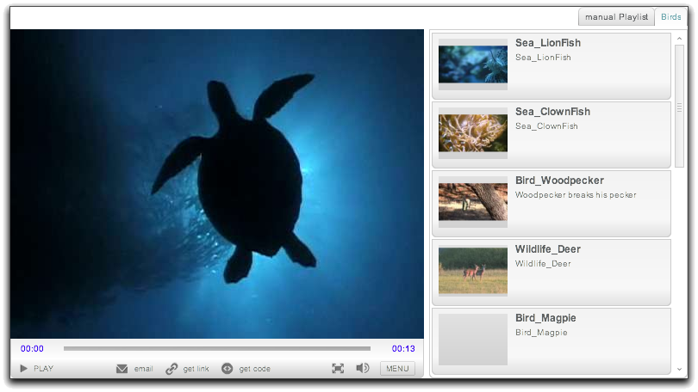
Components
TabBar
List
ListItem

Slide 26
TabBar Component
A series of tabs that page horizontally
Allows for a single selection in the collection
Displays left and right navigation when the number of tabs exceeds the component dimensions
Holds up to 100 playlists
By default, includes roll over menu to display all playlist
If only one playlist is assigned to the player, the TabBar can be set to invisible
<TabBar id="playlistTabs" height="22" tabAlign="right" hideSingleTab="true"/>
Notes:
26
Note that he tabbar can hold up to 100 playlists

Slide 27
List and ListItem component
List
A vertical scrolling List with user-defined list items
A List contains ListItems, each of which can contain other components
TileList
A grid-like list
Use ListItem for the items, just like List
ListItem
Serves as the visual definition of all videos rendered within a playlist
Cannot be used by itself
Must be defined within a List or TileList component
ONLY define 1 Listitem
Contains subcomponents (DTD)
Notes:
27

Slide 28
ListItem Component Example
<TabBar id="playlistTabs” height="22" />
<List id="videoList" rowHeight="78" automaticAdvance="true" data="{playlistTabs.selectedItem.videoDTOs}" selectOnClick="true" itemInsetV="4" itemLeading="2">
<ListItem boxType="hbox">
<Spacer width="8"/>
<VBox width="80" height="74" vAlign="middle">
<ThumbnailButton height="60" data="{currentItem}“source=“{currentItem.thumbnailURL}”/>
</VBox>
<Spacer width="7"/>
<VBox>
<Spacer height="3"/> <TitleLabel height="18" text="{currentItem.displayName}" truncate="true"/> <Label height="52" multiline="true" text="{currentItem.shortDescription}" truncate="true"/>
</VBox
<Spacer width="3"/>
</ListItem>
</List>
Notes:
28
playlistTabs.selectedItem.videoDTOs}" selectOnClick="true" itemInsetV="4" itemLeading="2">
Attributes here are not familiar outside of Brightcove – itemInsetV and itemLeading
This could be a slide that you call out the DTD cuz this describes every possible component
Good opportunity to point to DTD attributes and components….

Slide 29
Exercise 2: Modifying your Simple BEML Template

Slide 30
BEML - Layout
Notes:
30

Slide 31
Layout
All layout elements are contained within the <Layout> tag
Container type for the Layout defined by an attribute called “boxType”
<Layout id='application' width='480' height='540' boxType='vbox'>
<VideoPlayer … />
<Spacer height='5' />
<VBox height='264'>
<TabBar … />
<List …>
<ListItem …>
<Spacer width='8' />
<VBox width='80' height='74' vAlign='middle'>
<ThumbnailButton … />
</VBox>
Notes:
31

Slide 32
Parent Layout Elements: Containers
Valid Layout elements contained within the <Layout> tag:
Hbox (relative positioning of components from left to right)
Vbox (relative positioning of components from top to bottom)
Canvas (absolute positioning of components)
If a component’s size is not specified, it will fill the available space in the parent container
Notes:
32

Slide 33
Layout box attributes
All layout elements share certain core attributes:
width, height
gutter = spacing of child elements
padding = spacing between the box and its contents
gutter
height
padding
width
Notes:
33

Slide 34
HBox
HBox is a parent container that arranges components Horizontally
2 children
<HBox gutter=“5” padding=“5” hAlign=“left” vAlign=“top”>
<Image width=“20” height=“30” />
<Image width=“25” height=“20” />
</HBox>
Notes:
34

Slide 35
VBox
VBox arranges components Vertically
2 children
<VBox gutter=“5” padding=“5” hAlign=“center” vAlign=“bottom”>
<Image width=“20” height=“30” />
<Image width=“80” height=“20” />
</VBox>
Notes:
35

Slide 36
Exercise 3: Changing Layout to HBox

Slide 37
Canvas
Canvas requires you to specify coordinates
0,0
<Canvas padding=“5”>
<Image width=“20” height=“30” x=“5” y=“5” />
<Image width=“80” height=“20” x=“40” y=“15” />
</Canvas>
Notes:
37

Slide 38
Exercise 4: Changing Layout to Canvas

Slide 39
Exercise 4: Changing Layout to Canvas
Duplicate your original “SimpleBEMLtemplate” example and change the container from a VBox/HBox to a Canvas layout container.
In the layout element, double the values of the width and height to make it bigger.
Set the x and y of each component to see how it affects the layout.
Name this file “SimpleBEMLtemplateCanvas”
Solution: SimpleBEMLTemplateCanvasEx4.xml
Notes:
Good way to get started is to start with an existing template.
The out of the box video player component, hit duplicate at the bottom

Slide 40
Back to Components…
Notes:
40

Slide 41
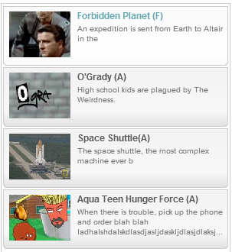
TitleLabel Component
A Label component that can render a “selected” state
Useful for lists where you need to distinguish the selected state
Used to indicate which video on the list is currently loaded in the player
Notes:
41

Slide 42
TileList Component Example
TileList
A grid list with user-defined list items
Useful for creating a horizontal list
Contains ListItems
Has a minimum size of 100x50
<TileList id=“videoList" rowHeight="60" columnWidth="200“ automaticAdvance="true"> <ListItem boxType="hbox" padding="5" gutter="10">
Notes:
42

Slide 43
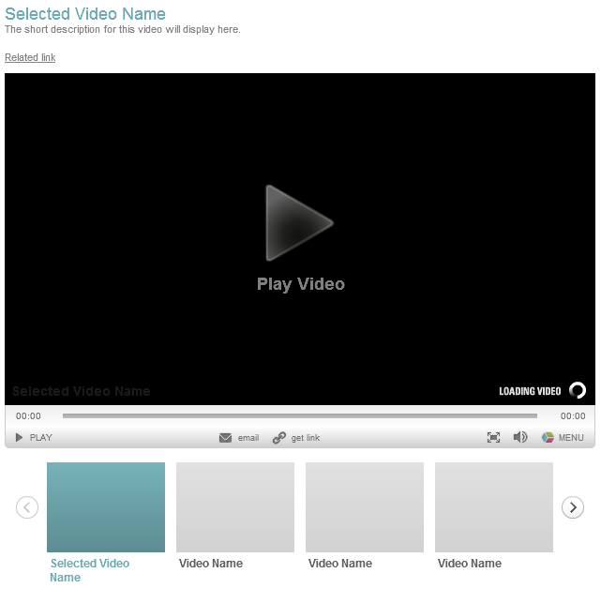
Video Player with Horizontal List

Slide 44
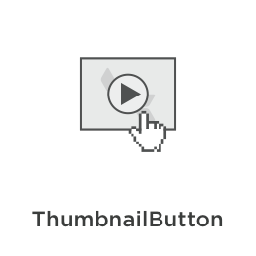
Thumbnail Button
Displays an image; when the viewer moves the cursor over the image, the button displays a play icon
Notes:
44

Slide 45
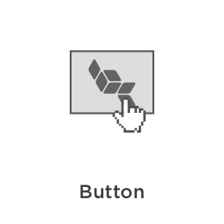
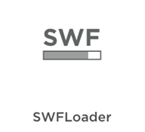
Components
A clickable graphic with a label that can broadcast events
Enables loading custom components that can be positioned and sized within a player
The loaded SWF is passed a handle to the runtime API so that it may listen for events and interact with the rest of the player
Notes:
45

Slide 46
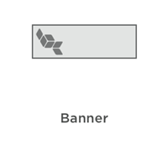
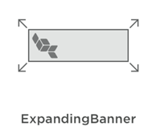
Banners
The Banner plugs into the advertising capabilities in a player. When a banner is included, a new format is allowed and appended to all ad server calls, informing the ad server that a banner can be displayed
The size of the banner dictates the ad format supported, so a 468x60 banner element by default supports a 468x60 banner ad format
Additional ad formats can be specified as well, so that you can use a large banner area to support several smaller sizes of banner
How those banners are scaled and aligned within the larger area is controlled by the Banner's attributes
Plugs into the advertising capabilities in a player – it be made to temporarily appear over other components (such as the List during a pre-roll ad)
The size of the banner dictates the ad formats supported, so a 468x60 banner element by default supports a 468x60 banner ad format and a 468x60 synched banner unit

Slide 47
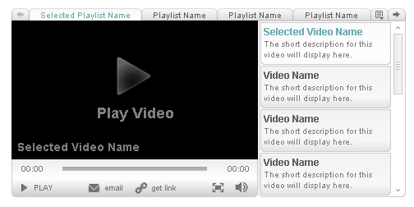
Sample design
Notes:
47

Slide 48
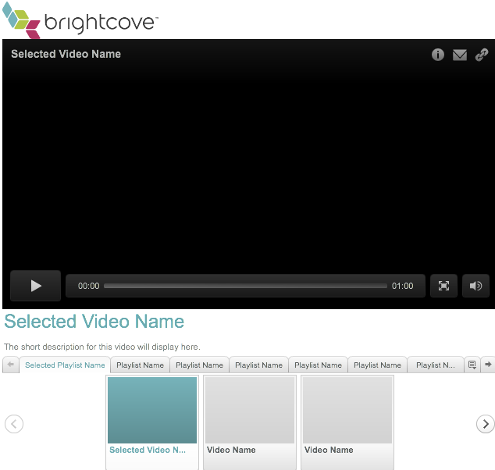
Exercise 5: Create A complex Layout

Slide 49
Data Binding
Notes:
49

Slide 50
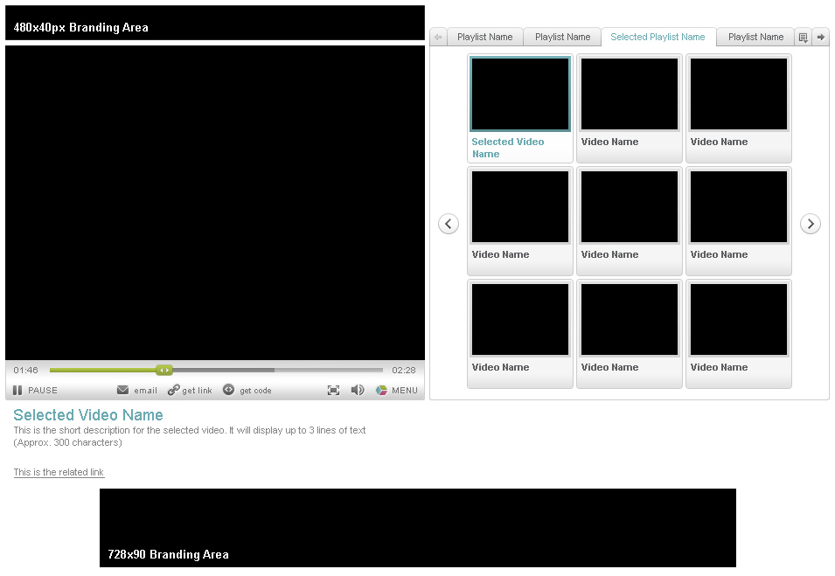
Displaying Content
Data we can obtain dynamically through data binding
© 2010 Brightcove, Inc. All rights reserved.
Notes:
50

Slide 51
Data Binding in Templates
data – value of a property - can be bound to a component specific attribute
To set the value of an attribute, you use the ID and properties of another object that has video or playlist data bound to it

Slide 52
BEML: Data Binding
The simple binding syntax looks like this:
<Element attribute="{component.object.property}" />
<Label text="{videoPlayer.video.displayName}" />ç
{ the braces indicate data binding }
52
© 2010 Brightcove, Inc. All rights reserved.
Notes:
52

Slide 53
Where to Find Properties
DTO(Data Transfer Object)
Player API DTO
Video DTO
Playlist DTO
These objects contain Properties and Metadata set by end users in the Media Module
Find details of the DTOs in the Player API reference: http://docs.brightcove.com/en/player/
Developers who will be creating applications with the APIs:
Use Player API version of the Video DTO!
(not the Media API version)

Slide 54
Some Useful Video DTO Properties
Video DTO Properties | Description
displayName | Name of video displayed in Player
linkText | Publisher-defined link text
linkURL | Publisher-defined URL that points to an information or containing page for this Video.
thumbnailURL | URL of a thumbnail image
shortDescription | Brief description of Video
54
© 2010 Brightcove, Inc. All rights reserved.
Notes:
54

Slide 55
How data binding Works
DTOs are downloaded with the player
Browser Memory
Video
DTO
Functionality to assign data via data binding built into player
Playlist
DTO
Custom JavaScript application can retrieve the DTO data via the Brightcove Player API
Player

Slide 56
Component IDs
The majority of the component IDs are variable and optional
<Image id=“catImage” source=http://url.com/cat.jpg”/>
The following components have required ID values that enable them to have data bound to them automatically
VideoPlayer, VideoDisplay, ChromelessVideoPlayer components: id="videoPlayer”
List and TileList components: id="videoList"
TabBar component: id="playlistTabs"
ComboBox component: id=“videoCombo” or “playlistCombo” depending on how used
For more, see http://support.brightcove.com/en/docs/data-binding-player-templates

Slide 57
data binding Elements – Components - Objects
Component | Object | Description
TabBar, List and TileList, | selectedItem (Playlist DTO or Video DTO) | The currently selected item (a playlist for TabBar; a video in a playlist for List or TileList)
VideoPlayer, VideoDisplay, ChromelessVideoPlayer | video (Video DTO) | The video currently loaded in the player
ListItem | currentItem (Video DTO) | The data associated with the corresponding item in the playlist
57
© 2010 Brightcove, Inc. All rights reserved.
Notes:
57

Slide 58
Special properties for binding
Video Player
mediaDuration (seconds)
mediaPosition (seconds)
playing (boolean)
timeRemaining (seconds)
relatedMedia (array of Video DTOs – undocumented: use at your own risk!)
ListItem
index (integer)
Boolean value can be negated with a "!"
<Image source=http://files.brightcove.com/BCL-Training-Logo-Small.png
height="48" width="200" visible="{!videoPlayer.playing}"/>

Slide 59
Adcontext properties for binding
adContext
playPauseVisible (true/false)
playheadVisible(true/false)
maximizeVisible (true/false)
volumeVisible (true/false)
timePositionVisible (true/false)
Primarily for use with Custom Media Controls:
<Playhead visible="{adContext.playheadVisible}" mediaController="{videoPlayer}" />

Slide 60
time formatters
To display a milliseconds value in hh:mm:ss format, use a format function with MillisecondsTimecodeFormatter
<Label width="31" height="17" text="{format(videoPlayer.video.length, MillisecondsTimecodeFormatter)}" />
To display a seconds value in hh:mm:ss format, use a format function with SecondsTimecodeFormatter
<Label width="31" height="17" text="{format(videoPlayer.mediaDuration, SecondsTimecodeFormatter)}" />

Slide 61
Exercise 6: Data Binding – Adding the displayName

Slide 62
Binding With the ListItem Element
The ListItem element has a special property:
currentItem
unique for each instance of the ListItem
currentItem is the information for the video at that position
Use it to automatically add specific information to the ListItem in a list
<TitleLabel text="{currentItem.displayName}" />

Slide 63
Data Binding Objects - Playlist
Some useful Playlist properties:
displayName - Name of Playlist displayed in Player
shortDescription - Descriptive text about the playlist
videoDTOs – a array of VideoDTOs of the videos in the playlist (use with Lists)

Slide 64
Data Binding Objects - Playlist
In this code example, the List component’s data attribute is bound to the playlist property of the currently selected TabBar tab
Effect: This populates the playlist the viewer has selected (via the TabBar) in the list of videos to choose from
<List id='videoList' rowHeight='78' automaticAdvance='true' data='{playlistTabs.selectedItem.videoDTOs}' …
Tab bar (component)
Selected tab (object)
Playlist (property)
© 2010 Brightcove, Inc. All rights reserved.
Notes:
64

Slide 65
Getting Data from one component to another
Element | Corresponding data
{videoList.selectedItem} | The selected item in the video List. List component must have id=“videoList”. Can use with the video attribute of VideoPlayer
{playlistTabs.selectedItem.videoDTOs} | The list of videos in the playlist corresponding to the selected tab.
© 2010 Brightcove, Inc. All rights reserved.
Notes:
65

Slide 66
Exercise 7: Wire up the Data Binding to the Objects
Solution: BEMLDataBindingEx7.xml

Slide 67
Style
Notes:
67

Slide 68
Understanding Theme and Style
<Theme> is global: it declares the theme to use: “Deluxe”, “Flat” or “Minimal”
<Theme> is required in all templates to allow styling in the UI
The Theme element has a style attribute set to “Light” or “Dark”
<Style> is individual: applies specific colors to specific component elements
<Style> is always a child of <Theme>
CSS must be defined within CDATA sections
You also have the option to import a CSS file (rather than include it all in the template) – set the URL for the external CSS file as the value of the Theme style attribute
© 2010 Brightcove, Inc. All rights reserved.
Notes:
68

Slide 69
Defining Global Fonts
Define global fonts in the Theme tag:
<Theme name="Deluxe" style="Light"
bodyFont=”Arial"
titleFont=”Arial Bold"
linkFont=”Arial Bold" />

Slide 70
CDATA
<Style class/id=“[Component Name/id]”>
<![CDATA[
/* CSS goes here */
]]>
</Style>

Slide 71
Setting individual styles
Each component contains style classes for its UI elements
e.g, for the button elements of the Video Player:
<Style id=“videoPlayer”>
<![CDATA[
.buttons {
text: #777777;
rolloverText: #B0C645;
disabledText: #AAAAAA;
icons: #777777;
rolloverIcons: #B0C645;
disabledIcons: #AAAAAA;
}
]]>
</Style>
© 2010 Brightcove, Inc. All rights reserved.
Notes:
71
Call out that some of this stuff is specific CSS to Brightcove.
Where is the complete style reference can be found online

Slide 72
Setting Fonts for Individual Components
Fonts can also be defined for any element that has the font attribute:
<Style id="playlistTabs">
<![CDATA[
.tabs {fontFace: "Arial Bold";fontSize: 14;}
]]>
</Style>

Slide 73
Syntax
Single element
sets the text color for the nowPlaying title
All elements
sets the background color for all labels
<Style id=“videoPlayer" >
<![CDATA[
.title { text: #FF0000; }
]]>
</Style>
<Style class=“Label” >
<![CDATA[
.body { color: #FF0000; }
]]>
</Style>
© 2010 Brightcove, Inc. All rights reserved.
Notes:
73

Slide 74
BEML Styling IS NOT standard CSS
BEML uses CSS syntax but is NOT CSS
Flash has its own styling in CSS syntax, but that’s not BEML CSS either
BEML uses CSS for friendly interface
Look at the component-css.zip and the StyleGuide.css files in the class downloads for information on properties for different components that can be styled
© 2010 Brightcove, Inc. All rights reserved.

Slide 75
Custom Skins
Style components of custom player templates
Gives you fine-grained control over the appearance of your player templates.
A skin
An image file that you create and host that you can use to change the appearance of some feature of a BEML player component.
Use skins to
Style the background of the overall player
Change the default thumbnail image
Change the players buttons

Slide 76
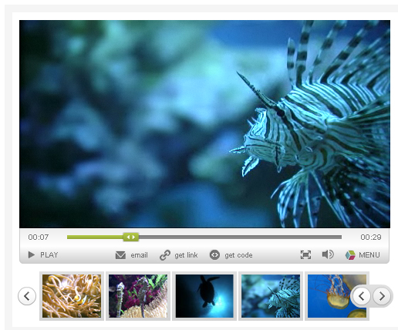
Default Styling

Slide 77
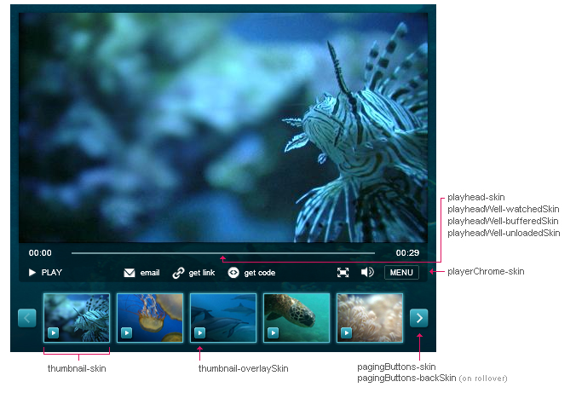
Skins Applied to Several Components

Slide 78
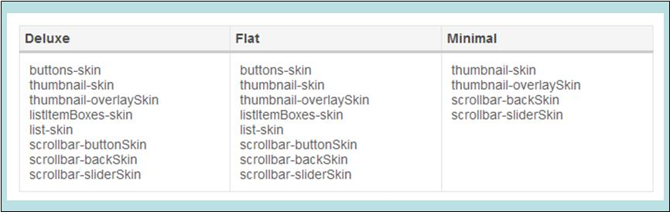
Setting skins in the Theme and Style Elements
You can set skins for all components by using the Style element within the player template's Theme element
To set a style using the Theme or Style tags in the BEML, the form would be
Note that each selector is preceded by a period (.button). The selector is what precedes the hyphen in the key, and the property is what follows. So button-skin;value in becomes .button {skin:value;}
<Style class=“List">
<![CDATA[ .buttons { skin:http://server/skin1.png; } ]]>
</Style>

Slide 79
Custom Player Themes
Customize nearly every aspect of a player using Flash and .fla files you can download from Brightcove
See http://support.brightcove.com/en/docs/custom-player-themes for details
Reference the path to your custom theme swf using the name attribute of the Theme tag

Slide 80
Exercise 8: Modify the Style for a Template

Slide 81
Further Customization (Bonus Content)
Notes:
81

Slide 82
Further BEML Customization
Localization
Custom Modules

Slide 83
Localizing with BEML
BEML allows you to localize
individual strings within components
e.g. buttons, labels, tooltips
entire templates
all the buttons and labels within a template
Supported languages
All, except right-to-left languages (e.g. Arabic and Hebrew)
Notes:
83

Slide 84
Localizing with BEML
<Labels> tag allows you to specify strings
Override for specific components
Reference an external BEML file for all labels
Example Labels usage:
<Labels> <label key="controls play">GO!</label> </Labels>
Example Labels file:
<Labels file="http://www.yourserver.com/de_player_labels.xml" />
Notes:
84

Slide 85
Example: Working with Labels

Slide 86
Exercise 11: Working with Labels
Duplicate your SimpleBEML Template
<Labels>
<label key="controls play">GO!</label>
</Labels>
Insert the <Labels/> tag after <Runtime> to change ‘Play’ in control bar to ‘GO!’
Solution: BEML LabelsEx11.xml

Slide 87
Localizing A Player – External XML File Example
<?xml version="1.0" encoding="UTF-8" standalone="yes"?> <Labels xmlns:xsi="http://www.w3.org/2001/XMLSchema-instance">
<!-- Video player chrome controls -->
<label key="controls play">PLAY</label>
<label key="controls pause">PAUSE</label>
<label key="controls menu">MENU</label>
<label key="controls play tooltip">Play</label>
<label key="controls pause tooltip">Pause</label>
…
Notes:
87

Slide 88


Custom Modules
<Modules> tag allows you to specify 3rd party hosted SWFs
Can access the Player API
Can access the BEML components
Example could be a Web Analytics SWF
HOSTED outside of Brightcove
Use Modules for non-displaying plugins; use SWFLoader for visible custom components
Example Labels usage:
<Modules>
<Module file='http://mysite/mycomponet.swf' />
</Modules>
Can go anywhere inside Runtime, but not nested in another element

Slide 89
Summary
Notes:
89

Slide 90
What did we Learn?
BEML can be used to:
3 Parts to BEML
Components, Layout, Styling
Data Binding wires it all together
Workflow:
Design
Identify Components
Identify Layout
Merge Components and Layout
Data Bind the components
Style
Publish!
© 2010 Brightcove, Inc. All rights reserved.

Slide 91
Where Next?
Notes:
91

Slide 92
Spectrum of Visual Customization
Methods
Publishing Module
BEML
Design Capabilities
Out-of-the-Box Templates
Styling
Layout
Size
CSS
Basic Design
HTML / XML
Skills
© 2010 Brightcove, Inc. All rights reserved.
Notes:
92

Slide 93
Spectrum of Visual Customization
Methods
Publishing Module
BEML
Player APIs
Design Capabilities
Out-of-the-Box Templates
Styling
Layout
Size
CSS
Custom controls
Comments/Ratings
Non-Standard UI
Custom SWFs
Basic Design
HTML / XML
ActionScript/JavaScript
Skills

Slide 94
Developer Training
Developer is a one day training session session designed for developers with JavaScript or ActionScript experience
This course will give you a comprehensive overview of the extensive programming capabilities of the Brightcove platform and how to use them in creating customized solutions
Capabilities such as BEML, the Media API, the Player API and the Ad API will be covered

Slide 95
Brightcove Forums
http://forum.brightcove.com/
Post questions and receive help from Brightcove developers and other users
Get help with BEML, data binding, player api and more

Slide 96
Thank You
Notes:
96

